Slide 1
Sequence
Notes:
LO: I can use logical reasoning to explain how some simple algorithms work.

Slide 2
Algorithm
Sequence
Notes:
Introduce students to key vocabulary for this lesson:
Algorithm: An unambiguous procedure or precise step-by-step guide to solve a problem or achieve a particular objective.
Sequence: “When we sequence things, we arrange them in a particular order. Sequence-based algorithms are made from a precise set of instructions.”

Slide 3
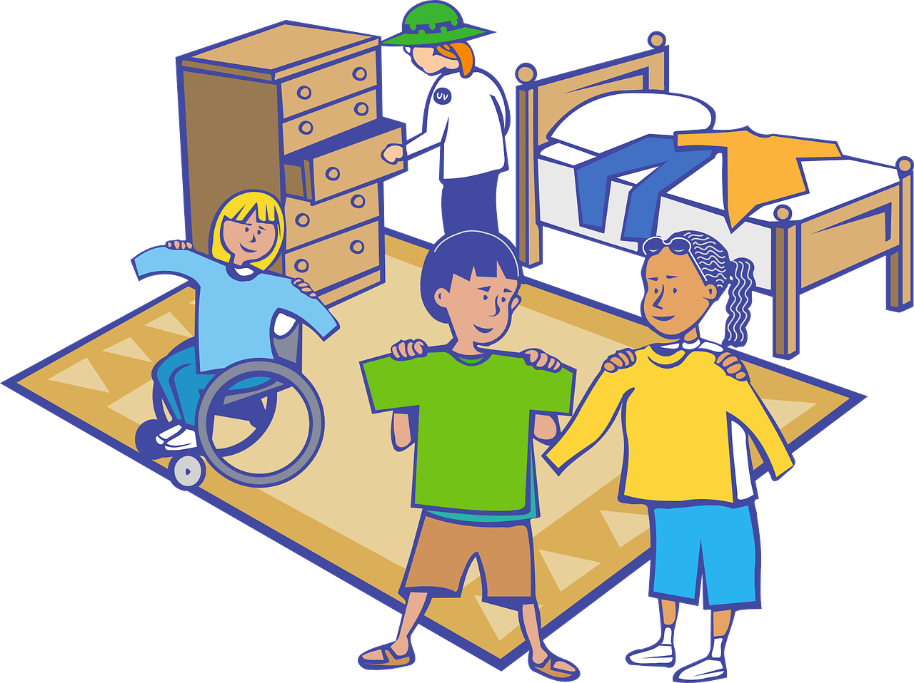
Notes:
When we sequence things, we arrange them in a particular order. Sequence-based algorithms are made from a precise set of instructions.
Students will have seen and had experience of many types of sequence, sometimes the order of the sequence is important, sometimes less so.
Ask students to think about the examples shown in these slides, which sequences need to be in the right order?
The alphabet (has to be in the right order)
Recipe (doesn’t always have to always be in order)
Brushing teeth (has to be in the right order)
Getting dressed (order isn’t as important since some people might put their socks on before trousers etc)

Slide 4
Notes:
Can children share their sequence for brushing teeth?
You may want to capture the sequence by writing this on a large sheet of paper?
Do your students all brush their teeth in the same way?

Slide 5
A sequence is when we arrange something in a particular order. Sequence-based algorithms are made from a precise set of instructions.
Notes:
Explain to students about the importance of sequence in computing/coding.
In sequence-based algorithms, such as a recipe to bake a cake, the order of many (though not all) of the steps is crucial. Similarly, most programming languages are based on a series of statements to sequentially process. The outcome of a program will depend not only on the constituent commands but their order.

Slide 6
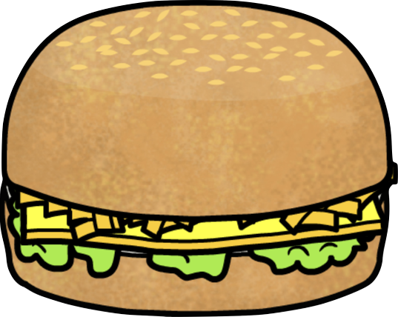
1 slice of brown bread
1 egg
2 slices of cucumber
1 tomato
1 slice of cheese
1 slice of brown bread
Notes:
Introduce your students to Bradley’s Bap Shop on this slide.
Explain that Bradley’s customers are very fussy about their sandwiches and only want a sandwich made in a particular way.
For this activity, you can can either allow students to make their own real sandwich or use the Busy Things sandwich maker.
(https://www.busythings.co.uk/lgfl-login/?activitytag=project_makesandwich)
Can you make the sandwich in the correct sequence?

Slide 7
1 slice of brown bread
1 egg
2 slices of cucumber
1 tomato
1 slice of cheese
1 slice of brown bread
Notes:
Explore the misconceptions children may have had about making the sandwich, did your students make the sandwich from the bottom up?

Slide 8
1 slice of brown bread
1 egg
2 cucumbers
1 tomato
1 slice of cheese
1 slice of brown bread
Notes:
Now ask your students to make their own sandwich recipe and then ask others to make it!
For this activity you can can either allow students to make their own real sandwich or use the Busy Things sandwich maker to explore this activity:
https://www.busythings.co.uk/lgfl-login/?activitytag=project_makesandwich

